Slide 1
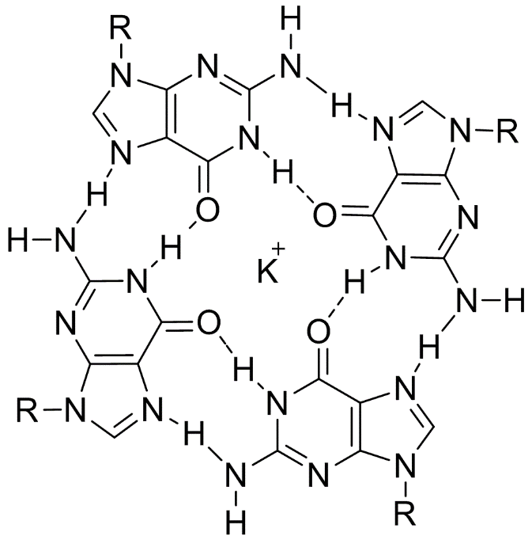
NCBIFetch and Final Configurations

Slide 2
NCBIFetch
What is NCBIFetch.
BioJava external source.
How does it work ?
Wrapper objects and methods from BioJava package.
Why was NCBIFetch used?
Best approach to retrieve sequences from NCBI and to write them in a readable file to our program.
BioJava methods are specific to bioinformatics processes.

Slide 3
Accession numbers for user input
Accession numbers used in testing and deployment of GFinder:
AE004437 - Halobacterium sp. NRC-1, complete genome
AE004438 - Halobacterium sp. NRC-1 plasmid pNRC200
AF016485 - Halobacterium sp. NRC-1 plasmid pNRC100

Slide 4
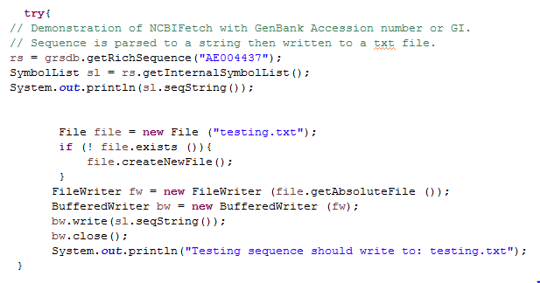
NCBIFetch Syntax for GFinder

Slide 5
Evolution of regex for GFinder

Slide 6
Initial regex pattern for GFinder
Default g-quadruples algorithm:
G>/=3Nx G>/=3Nx G>/=3Nx G>/=3Nx
Initial GFinder regex pattern:
([gG]{3,}\\w{1,7}){3,}[gG]{3,}
Identified 3 candidate sequences within the pNRC100Plasmid of Halobacterium sp.

Slide 7
Methods to enhance GFinder regex pattern for wanted candidate sequence amount.
pNRC100Plasmid
Expansion of limit of found nucleotides between guanines. (loop for g-quadruplex motif)
([gG]{3,}\\w{1,30}){3,}[gG]{3,}
Identified 55 candidate sequences within the pNRC100Plasmid of Halobacterium sp.
Further fine tuning of pattern looping.
([gG]{3,}\\w{1,30}){2,}[gG]{3,}
Identified 138 candidate sequences within the pNRC100Plasmid of Halobacterium sp.

